Slide 1
Fundamentals of Analytical chemistry (221)
CHAPTER-7
Silicate Industry (Manufacture of Ceramic, Glass and Cement

Slide 2
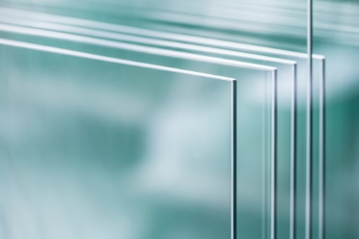
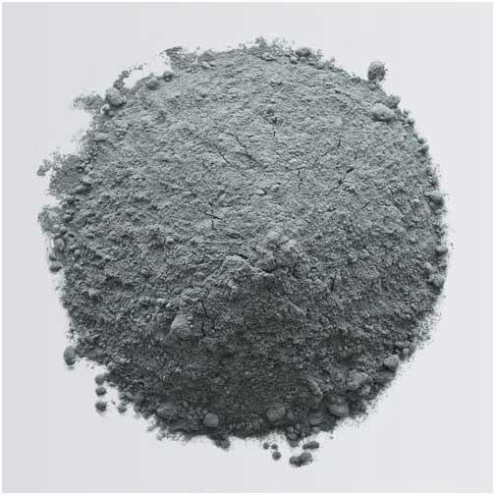
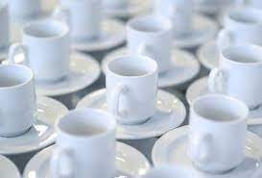
Cont’.....
Glass
Cement
Ceramic

Slide 3
Cont’.....
7.1 Structure and Types of silicate
Definition:
A silicate is a compound containing an ion in which one or more central silicon atoms are surrounded by electronegative ligands. Or,
Silicate, is a chemical compound containing silicon, oxygen, and one or more metals; such as:
aluminum, barium, beryllium,
calcium, iron, magnesium, manganese,
potassium, sodium, or zirconium.

Slide 4
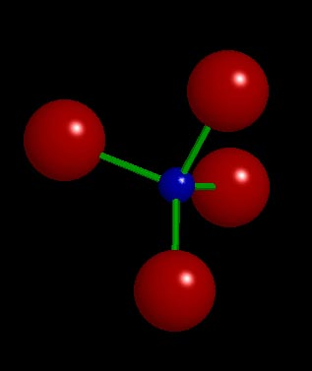
Cont’.....
Silicates are classified on the basis of Si-O polymerism; for example: The culprit: the [SiO₄]⁴⁻ tetrahedron
Silicates are widely distributed in nature, making up most of the earth's outer crust.
Silica, or silicon dioxide, SiO₂, is sometimes considered a silicate, although it is the special case with no negative charge and no need for counter-ions.
Silica is found in nature as the mineral quartz, and its polymorphs.

Slide 5
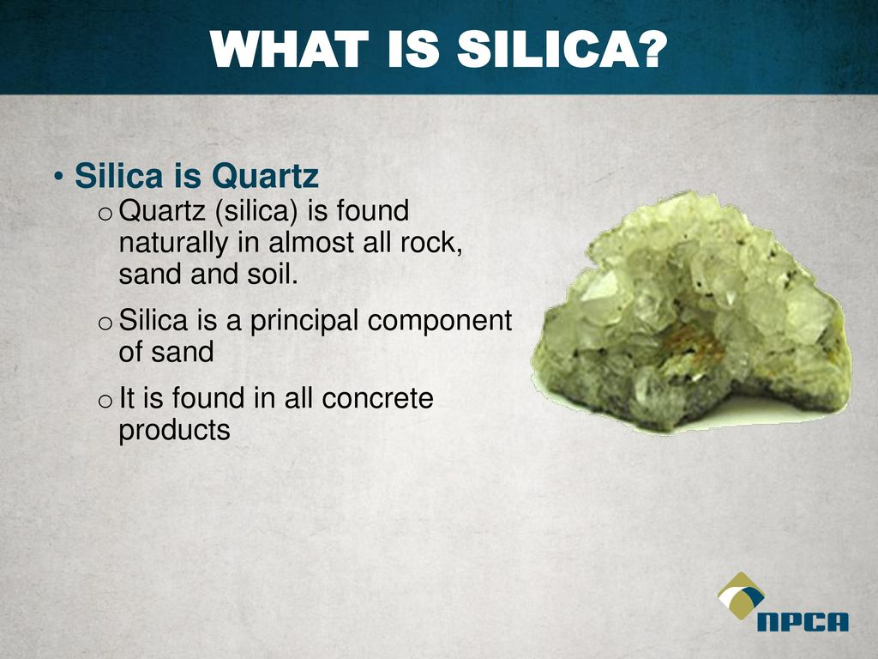
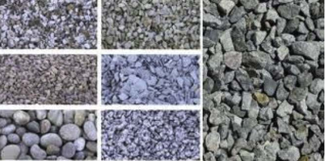
Cont’.....
What is silica?
Mineral – crystalline
or amorphous forms
Crystalline materials
have a highly ordered
Is the most common
element on the earth’s
surface.

Slide 6
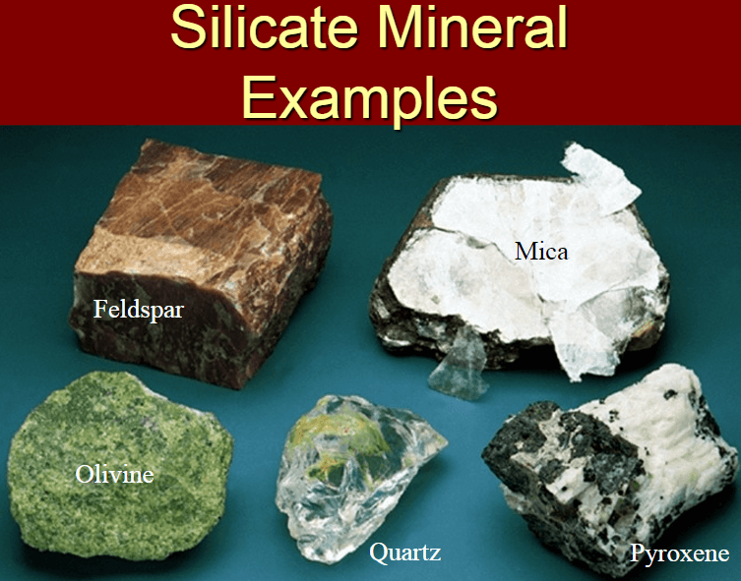
Cont’.....
Notes:
Minerals of silicate:- Feldspar, Mica, Olivine, Pyroxene and Quartz

Slide 7
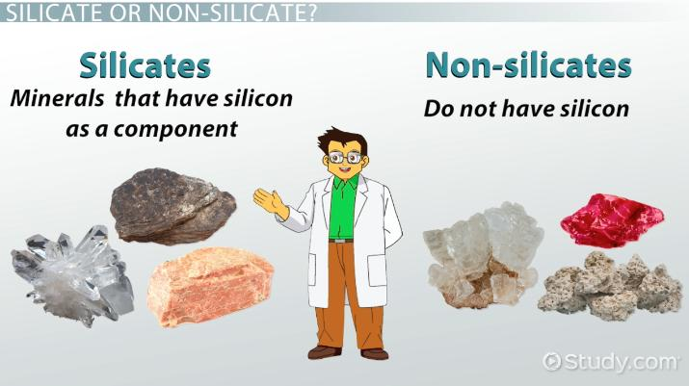
Cont’.....

Slide 8
Cont’.....
Structure of silicate.
In the vast majority of silicates, including silicate minerals, the Silicon atom shows tetrahedral coordination by 4 oxygens.
In different minerals the tetrahedral show different degrees of polymerization:
they occur singly, joined together in pairs, in larger finite clusters including rings, in chains, double chains, sheets, and three-dimensional frameworks.
The minerals are classified into groups based on these anion structures

Slide 9
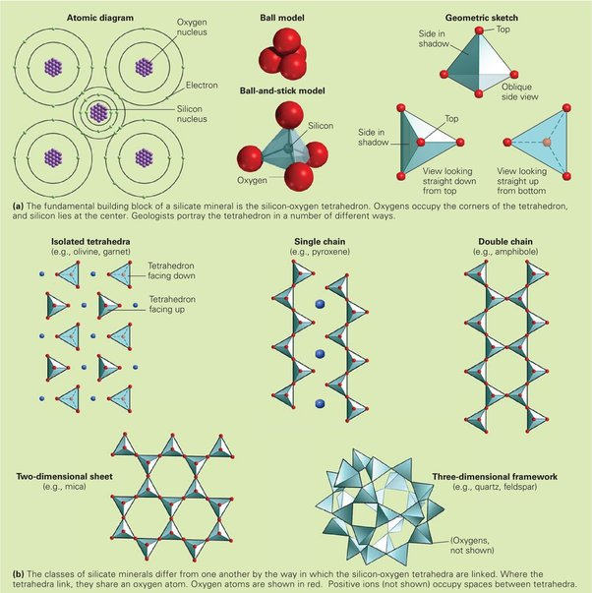
Cont’.....

Slide 10
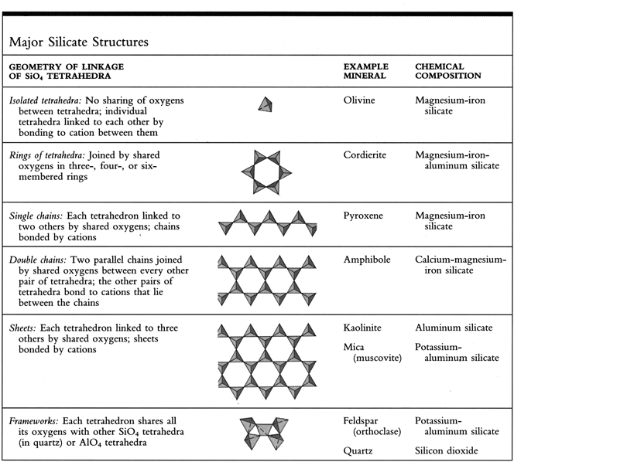
Major Silicate structures
Notes:
Isolated tetrahedral:- olivine
Ring of tetrahedral:- cordierite
Single chain:- pyroxene
Double chain:- amphibole
Sheet:- kaolinit(mica)muscovite
Frame work:- feldspar(orthoclass) quartz

Slide 11
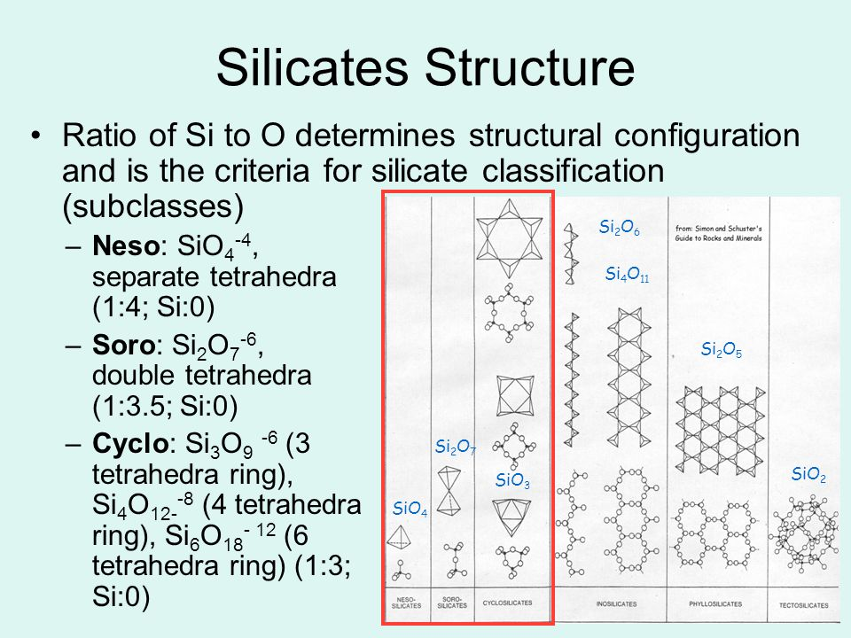
Cont’.....

Slide 12
Cont’.....
Mineralogically, silicate minerals are divided according to structure of their silicate anion into the following groups:
Nesosilicates (lone tetrahedron) - [SiO₄]⁴⁻, eg olivine.
Sorosilicates (double tetrahedra) - [Si₂O₇]⁶⁻, eg epidote, melilite group.
Cyclosilicates (rings) - [Si_{n}O_{3n}]^{2n−}, eg tourmaline group.
Inosilicates (single chain) - [Si_{n}O_{3n}]^{2n−}, eg pyroxene group.
Inosilicates(double chain) - [Si_{4n}O_{11n}]^{6n−}, eg amphibole group.
Phyllosilicates (sheets) - [Si_{2n}O_{5n}]^{2n−}, eg micas and clays.
Tectosilicates (3D framework) - [Al_{x}Si_{y}O_{2(x+y)}]^{x−}, eg quartz, feldspars, zeolites.

Slide 13
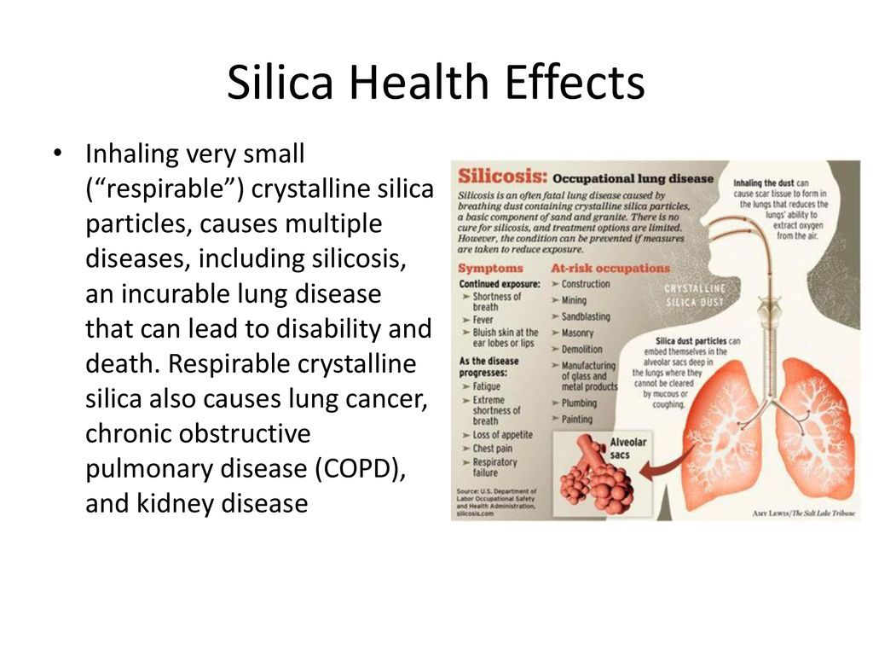
Health Effects of Crystalline Silica

Slide 14
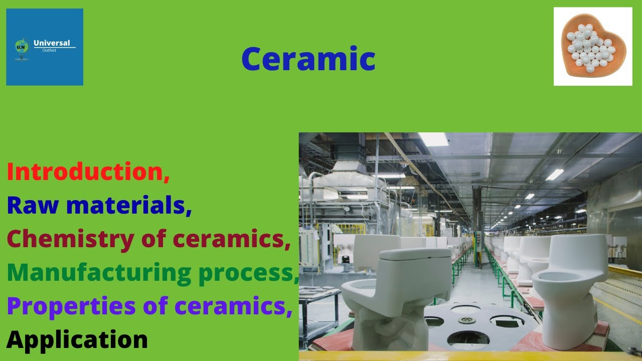
Ceramics

Slide 15
Cont’.....
Ceramics are defined as a class of inorganic, nonmetallic solids that are subjected to high temperature in manufacture and/or use.
Ceramics are any articles of pottery or clay products and manufacture of articles of plastic (easily shaped or molded) raw materials.
The most common ceramics are composed of crystalline oxides, carbides, and nitrides material.
Ceramic materials are brittle , hard, strong in compression, weak in shearing and tension.
Ceramic processing generally involves high temperatures, and the resulting materials are heat resistant or refractory.
Notes:
The most common ceramics are composed of crystalline oxides, carbides, and nitrides material

Slide 16
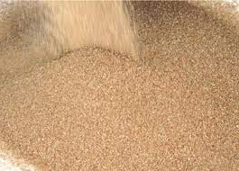
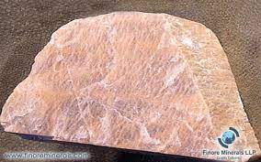
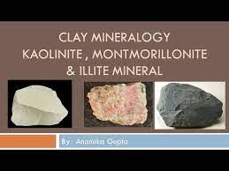
Cont’.....
Basic raw materials: - The three main raw materials used in making the classic ceramic products are Clay, feldspar, and sand.
Clays are product of decomposition mineral feldspar, and is more or less impure hydrated aluminum silicates that have resulted from the weathering of igneous rocks in which feldspar was a not worthy original mineral.
The reaction may be expressed as:
Sand
feldspar

Slide 17
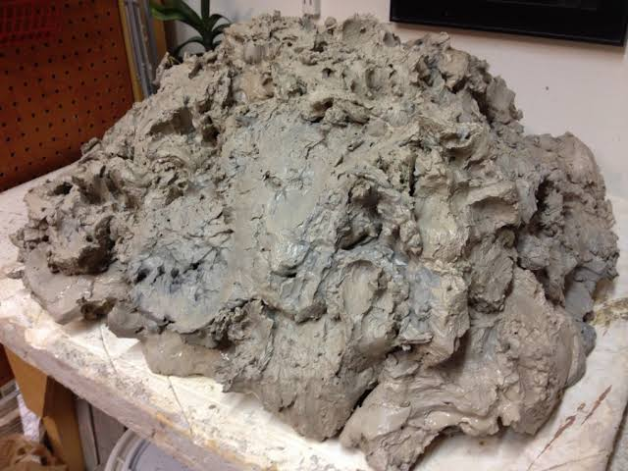
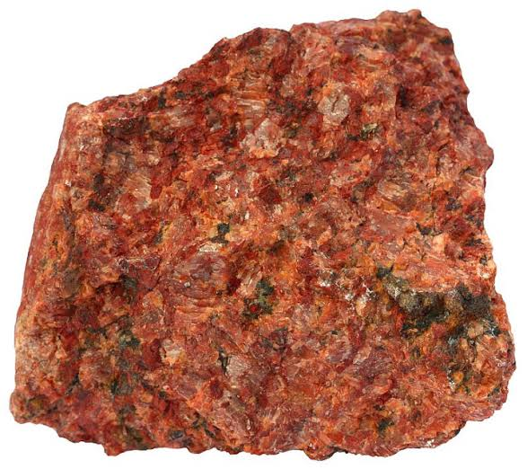
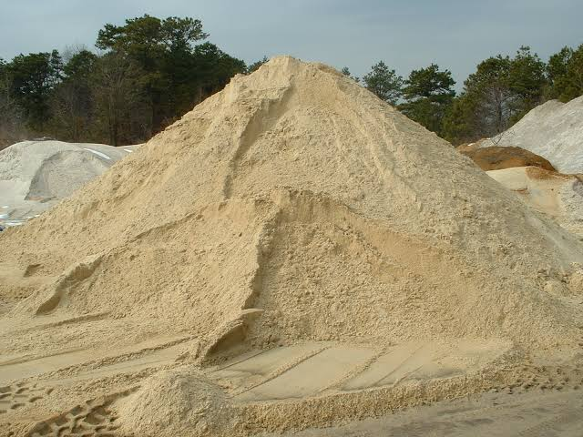
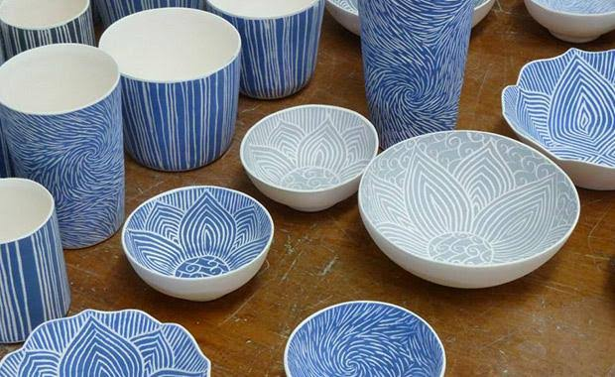
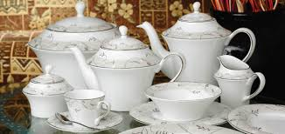
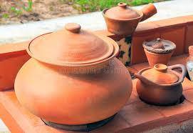
Cont’.....
Feldspar is the most abundant mineral found in crystalline rocks, commonest of which are granite and genesis

Slide 18
Cont’.....
There are a number of mineral species called clay minerals, but the most important are:
Kaolite(Al₂O₃.2SiO₂ .2H₂O);
Montmorillonite((Mg.Ca)O, Al₂O₃.5SiO₂ .nH₂O); and
Illite(K₂O, MgO, Al₂O₃, SiO₂ , 2H₂O, all in variable amounts)
Accompanying the clay minerals in the clays of commerce are varying amounts of feldspar, quartz, and other impurities such as oxides of iron.

Slide 19
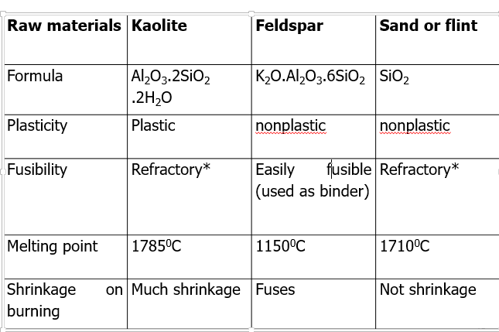
Cont’.....
Basic raw materials for ceramics

Slide 20
Cont’.....
There are three common types of feldspar:
Potash (K₂O.Al₂O₃.6SiO₂),
Soda (Na₂O.Al₂O₃.6SiO₂), and
Lime (CaO.Al₂O₃.6SiO₂), all of which are used in ceramic products to some extent.
Feldspar is great importance as a fluxing constituent in ceramic formulas.
In addition to the three principal materials, salts, & oxides are used as fluxing agents & special refractory ingredients.
Some of the more common fluxing agents which lower temperatures are;
Soda ash(Na₂CO₃)
Borax(Na₂B₄O₇.10H₂O)
Pearl ash(K₂CO₃)
Fluorspar(CaF₂)
Cryolite(Na₃AlF₆)
Iron oxides and etc

Slide 21
Cont’.....
Some of the more common special refractory ingredients (which can increase the heat resistance of materials) are:
Alumina(Al₂O₃)
Chromite(FeO.Cr₂O₃)
Magnesite(MgCO₃)
Lime(CaO)
limestone(CaCO₃)
Dolomite(CaMg.(CO₃)₂) & etc

Slide 22
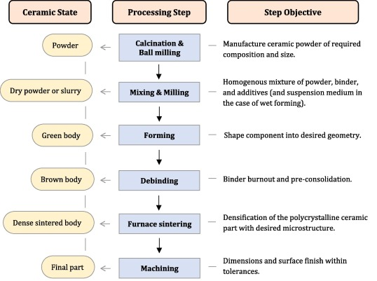
Cont’.....
Ceramics manufacturing steps:

Slide 23
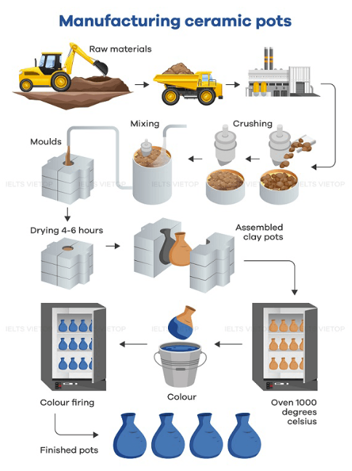
Cont’.....

Slide 24
General properties of ceramics
Physical and chemical properties:- Ceramics are chemically stable; they don’t undergo reduction and oxidation due to the presence of carbon and oxygen elements.
In addition to these the structures of ceramic crystal is compact and strong ionic chemical bonding lays stability of ceramic.
Hence, it is also heat resistant.
Optical properties:- Actually, there are different types of ceramic with different properties concerning optical property:
some ceramic are opaque and some are transparent depending on type of crystal present because each crystal or composition posses different refractive index, i.e., ability to bend light.
Mechanical properties:- Ceramics are general brittle solid.
They are resistant to compression that means posses high mechanical strength.
Electrical and magnetic properties:- ceramics are insulator and are non-magnetic except those ceramics, which contains transition metal with unpaired of electrons that are magnetic

Slide 25
Cont’.....
Classification of Ceramics
Depending on their use; ceramics can be classified as follows
Structural ceramics:- used mainly for constructing and structure related to this group.
Example; Brick block, hollow tiles, roof tile
Facing ceramics:- these are used for internal and external building
Refractory materials:- this is used for making ovens and apparatus operating at high temperature
Fine ceramics:- includes ceramic materials, which are used domestically like dishes, washing basin, decorative article etc.
Special ceramics: are these, which have specific properties and used for unique purposes. Example, those used in radio industry.

Slide 26
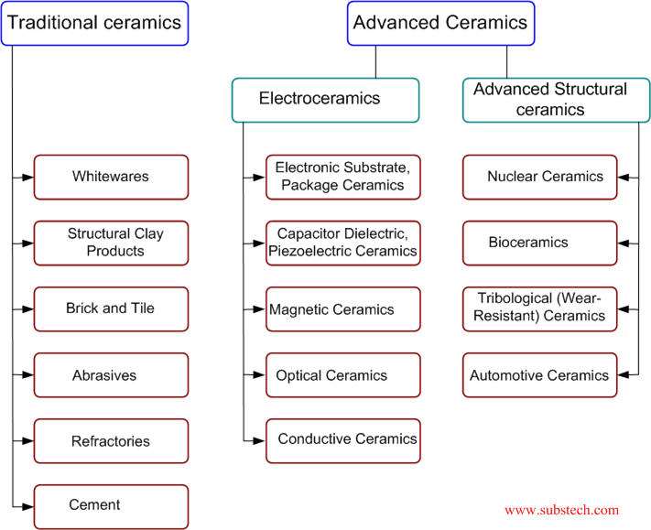
Cont’.....
Classification of ceramics

Slide 27
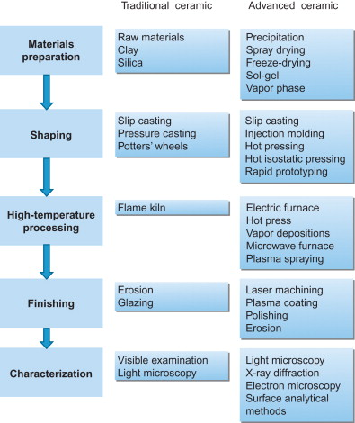
Cont’.....

Slide 28
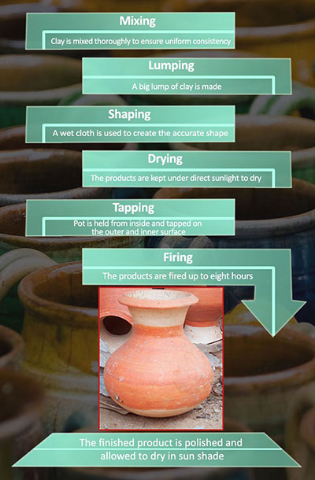
Cont’.....

Slide 29
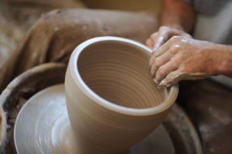
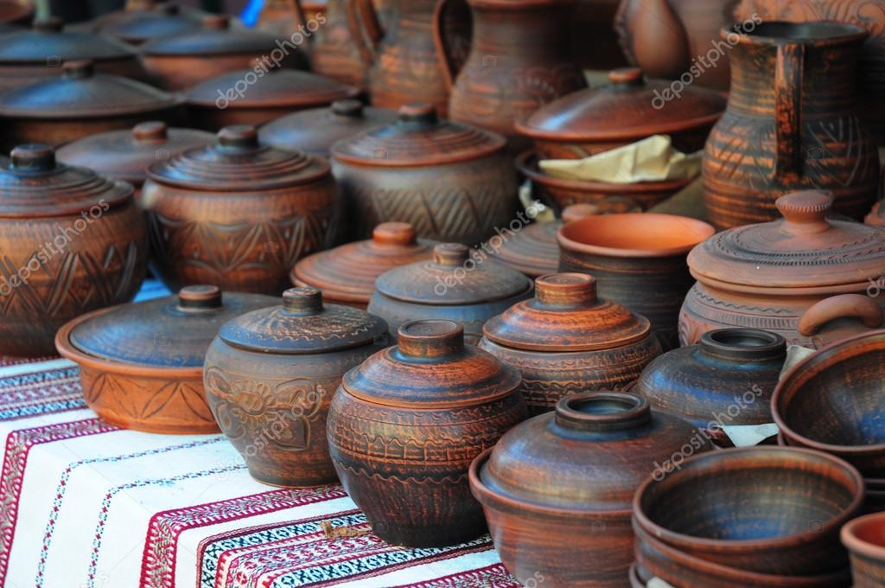
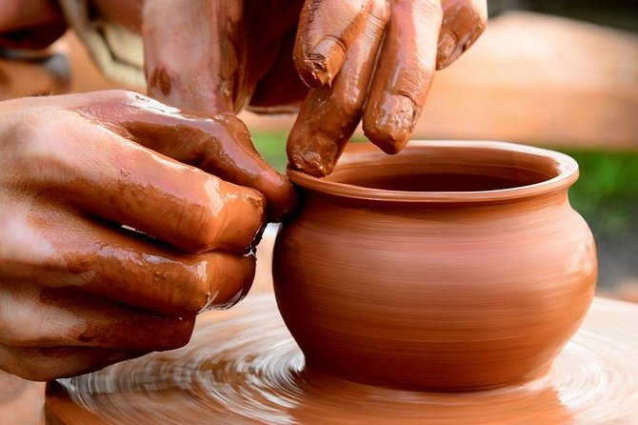
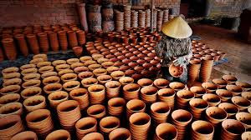
Cont’.....
Traditional Ceramics

Slide 30
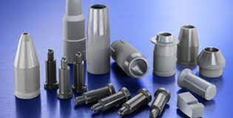
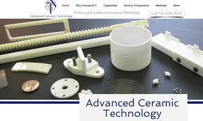
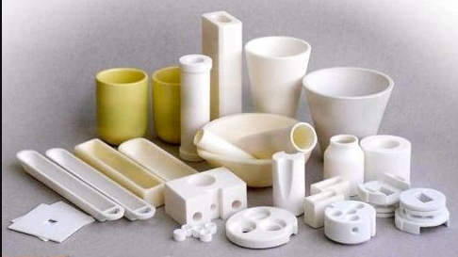
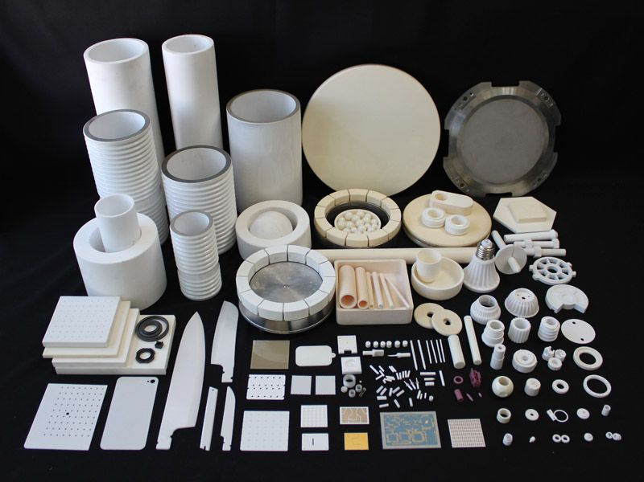
Cont’.....
Advanced Ceramics

Slide 31
Cont’.....
Manufacturing stages
There are two major common steps in manufacturing process of ceramics.
These are grinding of raw materials and Mixing or body preparation
Grinding of raw materials:- this involves the size of raw material before mixing. There are different methods of size reduction of these
Exposing to weather, sun, rain, forest
Calcination, using grinding mills, and etc.
Mixing or body preparation:- involves mixing of grinded raw material in a fixed proportion after purification. There are three major ways of body preparation or mixing
Body preparation using clay in plastic state
Body preparation using dry clay
Body preparation using clay slips filtering

Slide 32
Cont’.....
Chemical conversions, including basic ceramic chemistry
All ceramic products are made by combining various amounts of the foregoing raw materials, shaping, and heating to firing temperatures.
These temperatures may be as low as 700⁰C for some over glazes or as high as 2000⁰C for many verifications.
Such temperatures cause a number of reactions, which are the chemical bases for the chemical conversions(Ch) of;
Dehydration or “chemical water smoking” at 150 to 650⁰C
Calcination e.g; of CaCO₃ at 600 to 900⁰C
Oxidation of ferrous iron & organic matter at 350⁰C to 900⁰C
Silicate formation at 900⁰C & higher

Slide 33
Cont’.....
Major uses of Ceramics
It is used in construction and decoration of building, example bricks
In the manufacture of metals as refractory materials like furnace
Used in manufacturing of chemical products
In drainage of water and sewage
Used as insulator in electrical industry
In the sanitation(e.g., clay, zeolites and sand can be used in the treatment of water) ; and etc.

Slide 34
Cont’.....
What kind of clay do you use for ceramics?
The higher the maturing temperature of stoneware clay, the more durable and more water proof is the ware. Porcelain and kaolin clay are used for high-quality ware including laboratory equipment. Porcelain and kaolin clays are virtually identical and are considered the best clays available for making pottery
Is ceramic and clay the same thing?
Clay and ceramic are often used to describe different materials for making pottery. Clay is a type of ceramic, but not all ceramics are made of clay. Clay is a natural material that comes from the ground, and ceramics are various materials that harden when heated, including clay.
Notes:
Porcelain and Kaolin clay clay are used for high-quality ware including laboratory equipment

Slide 35
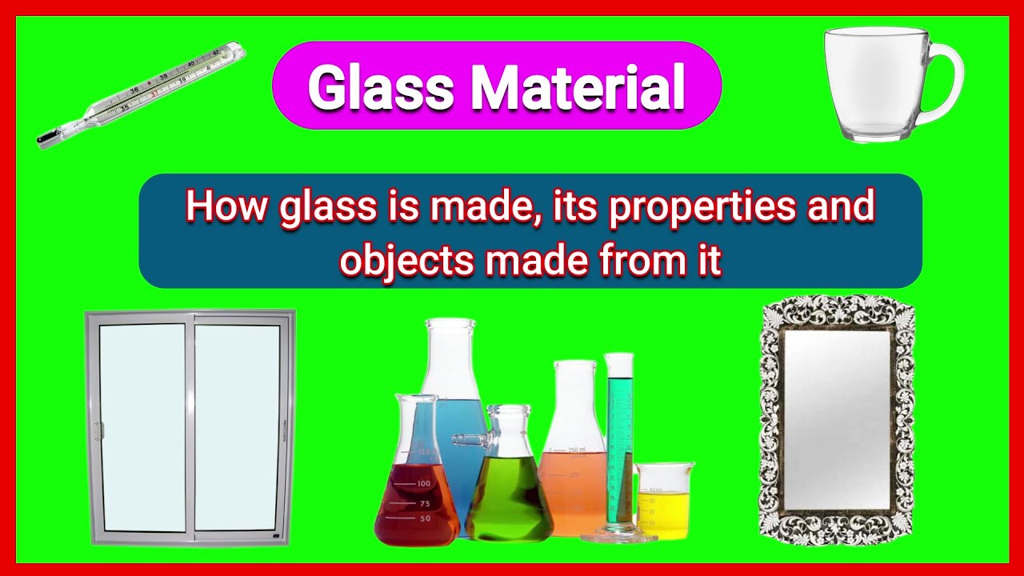
Glass and its properties

Slide 36
Cont’.....
Glass is can be defined as:
Physically: a hard, rigid, under cooled, brittle, non crystalline substance having no definite melting point and sufficiently high viscosity to prevent crystallization.
It is usually transparent, but sometimes opaque or translucent.
Melting point varies from 500ºc to 1650ºc
Density is medium (2-8gm/l)
Poor heat and electrical conductivity
Different optical activity (transparent, translucent and opaque

Slide 37
Cont’.....
Chemically: Glass is a fused mixture of silicates, alkali and alkaline earth compounds and other glass constituents such as calcium oxide, magnesium oxide, tin oxide, barium oxide, lead oxide, chromium oxide and etc.
Different glasses have different colors because of the presence of the first row transition elements as a result of d-d transition, excluding Sc & Zn.

Slide 38
Manufacture of glasses
Raw materials for manufacture of glasses are:
Silica (SiO₂)
Compounds of alkali metals, Na₂CO₃, NaNO₃, Na₂SO₄, K₂CO₃ and KNO₃
Compounds of alkaline earth metals, example; CaCO₃, CaO, BaCO₃; used for preparation of glasses which have higher refractive index
Oxides of heavy metals, PbO, Pb₃O₄
Calcium Phosphate, Ca₃(PO₄)₂; used for preparation of opalescent glass. Arsenic and antimony are added in the form of their oxides
Notes:
Calcium Phosphate, Ca₃(PO₄)₂; used for preparation of opalescent glass

Slide 39
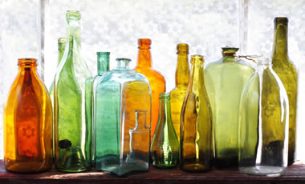
Cont’.....
Coloring materials:- Certain metallic oxides are added to fused silicates during the manufacture of glass to prepare glass of different colours.
For example: Fe₃O₄ is added to get yellow colour, Chromic oxide to get green colour, MnO₂ to get purple colour & Cobaltic oxide to get blue colour in glass.

Slide 40
Cont’.....
The following are stage involved in the preparation of glass.
Treatment and measurement of the raw material:- treatment is to mean purification of ingredient, measurement is quantification or fixing the amount, and it is the beginning of preparation of glass.
Mixing and melting: Involves mixing and heating the treated raw materials in a tanker by oil, to form molten glass.
Shaping:- the molten glass is molded to different shapes, this is done by casting( shape in cast-iron), blowing, pressing(apply pressure to shape glass), drawing and rolling
Stressing glass:- stresses can be added to impart strength to the glass articles and it is the last stage of glass preparation.
This involves heating of glass followed by cooling.

Slide 41
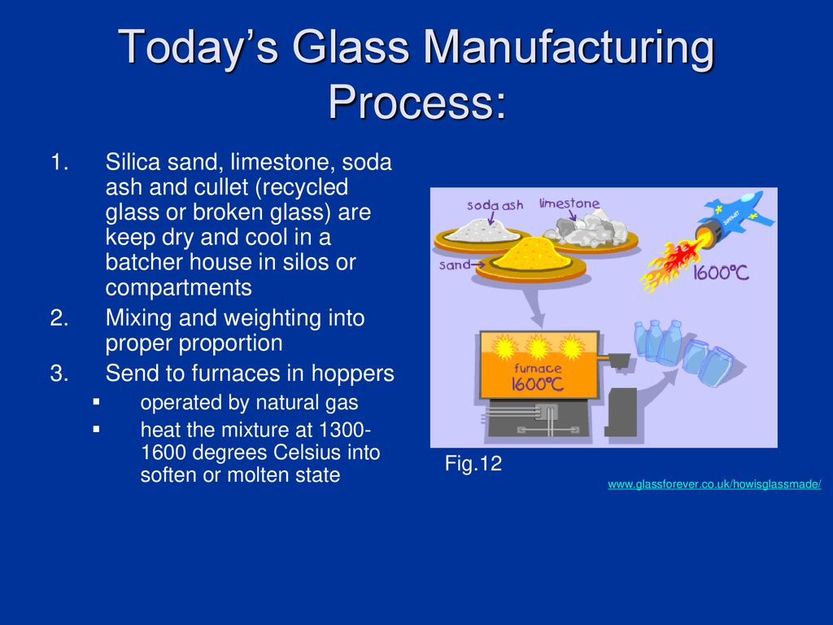
Cont’.....

Slide 42
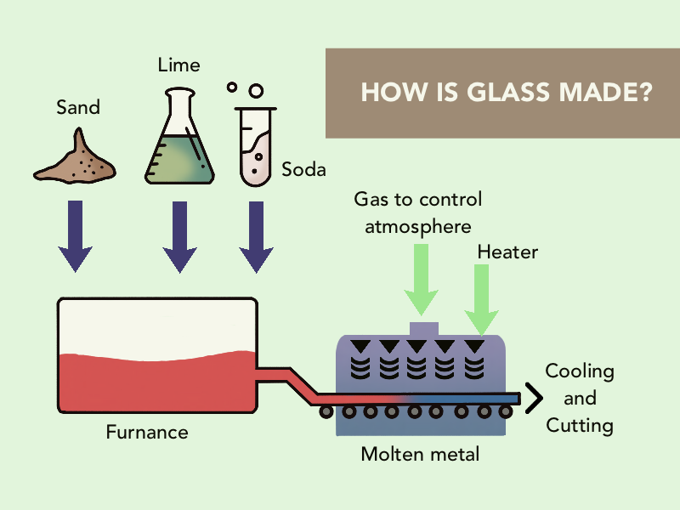
Cont’.....

Slide 43
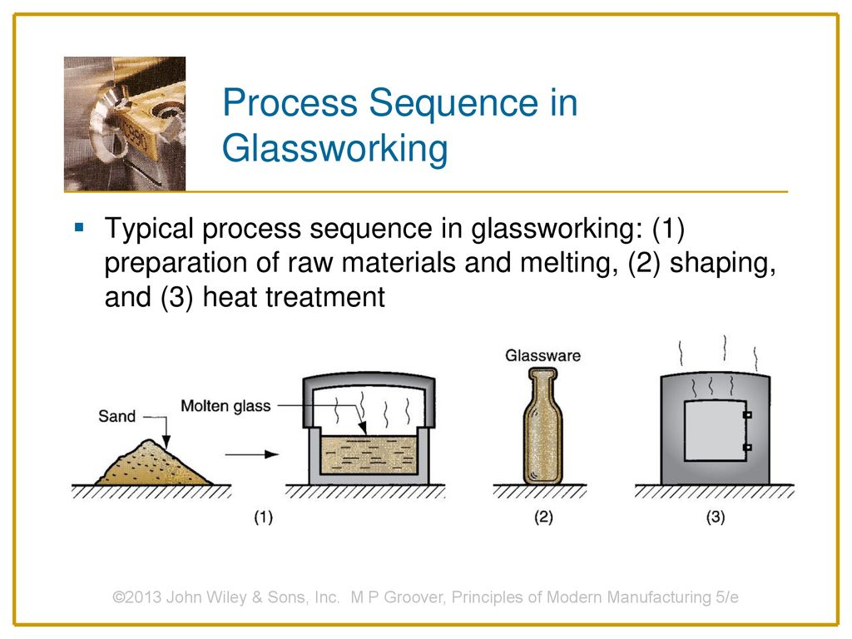
Cont’.....

Slide 44
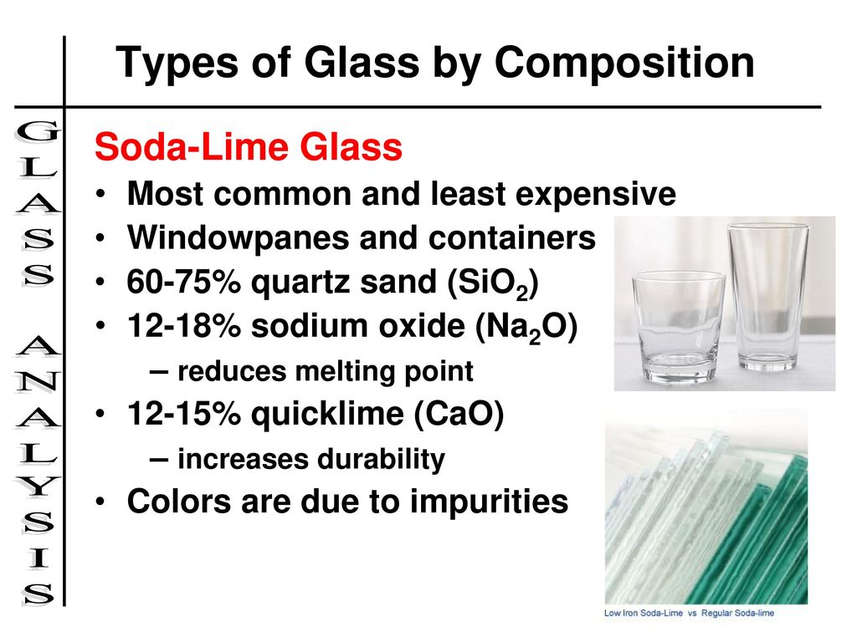
Cont’.....
Types of glasses: based on composition and uses
Soda-Lime Glass
low percentage of other materials added for coloring.
This type of glass is called soft glass, because it softens at lower temperature….. panes, dishes, bottles, tableware, lump bulb etc
Notes:
durability

Slide 45
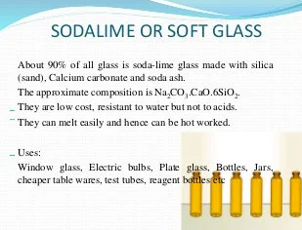
Cont’.....
Notes:
Resistant to water but not to acid.
They can melt easily & can be hot worked

Slide 46
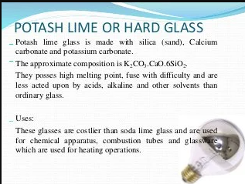
Potash glass
Potash-Lime Glass
Notes:
Potash lime glass is made with silica(sand), calcium and potassium carbonate.
They posses high melting point, fuse with difficulty and are less acted upon by acids, alkaline and other solvents than ordinary glass.

Slide 47
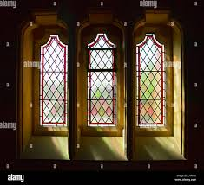
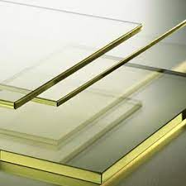
Cont’.....
Flint glass (Lead glass)
glass made of potassium
silicates and lead oxide.
Its approximate composition is:
Silica (45%), Lead Oxide (44%),
Na₂O (4%), K₂O(4%) and CaO(3%).
Flint glass has a higher density & transparency than ordinary glass & is used for making optical instruments as well as for ornamental purposes.
Uses: used in the manufacturing of lenses, prisms and electric bulbs.
Notes:
Flint glass has a higher density & transparency than ordinary glass

Slide 48
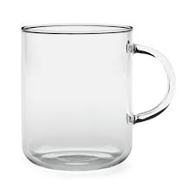
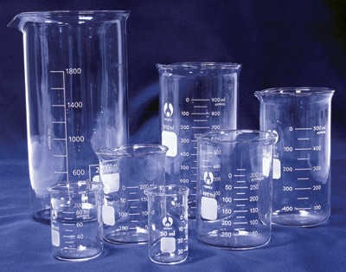
Cont’.....
Pyrex glass (Borosilicate)
Glass that contains borax as
major constituent.
Addition of certain amounts
of boron & aluminum oxides
produces a glass with a very low coefficient of expansion, known as pyrex glass.
This can withstand sudden alterations of temperature very well and is highly suitable for laboratory glass-ware such as flasks, beakers, etc., which are to be heated to high temperatures.
It posses high resistant to chemical attack and high temperatures.
Its aproximarte composition is: Silica(80%), B₂O₃ (12%), Na₂O(4%), Al₂O₃(3%), K₂O(0.5%) and CaO(0.5%).
Notes:
produces a glass with a very low coefficient of expansion, known as pyrex glass.
highly suitable for laboratory glass-ware such as flasks, beakers, etc., which are to be heated to high temperatures.
It posses high resistant to chemical attack and high temperatures.

Slide 49
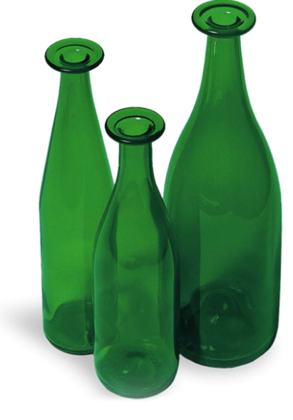
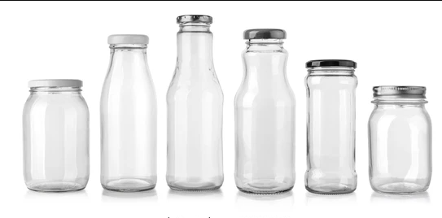
Cont’.....
Bottle glass
It is ordinary soda-lime glass containing MgO to the extent of 3.5% & Al₂O₃.Fe₂O₃ to the extent of 0.5%.

Slide 50


Cont’.....
Safety glass
It is used in making wind screens of automobiles, aero planes, railway trains, etc.

Slide 51

Cont’.....
Annealing
The full annealing process consists of heating to the proper temperature and then cooling slowly, through the transformation range, in the furnace.
The purpose of annealing is to produce a refined grain, to induce softness, improve electrical and magnetic properties, and sometimes to improve machinability.

Slide 52
Cont’.....
Here we give certain uses of glass which are as under:
Windows and doors.
Facades.
Reinforcement structures.
Tableware (plate, cups, bowls)
Insulation.
Conservatory.
Jar packaging for food.
Bottles for drinks

Slide 53
Manufacture of cement
Definition: Cement is a crystalline compound of calcium silicates and other calcium compounds having hydraulic properties.
Cement is a hydraulic binder, It is a finely ground, nonmetallic, inorganic material.
When mixed with water it forms a paste that sets and hardens by dehydration.
After hardening, it retains its strength and stability even under water.
The hydraulic hardening is primarily due to the formation of calcium silicate hydrates.
Accordingly, cements consist of those substances, which react with the mixing water to form calcium silicate hydrates.
Notes:
When mixed with water it forms a paste that sets and hardens by dehydration.
The hydraulic hardening is primarily due to the formation of calcium silicate hydrates.

Slide 54
Cont’.....
Types of Cement
Cements are considered hydraulic:
because of their ability to set and harden under or with excess water through the hydration of the cement’s chemical compounds or minerals.
There are two types of hydraulic properties:
Those that activate with the addition of water and,
pozzolanic that develop hydraulic properties when the interact with hydrated lime Ca(OH) _{2.}
There are various types of cements; the main ones are the following:
Portland Cement
Notes:
There are two types of hydraulic properties
Those that activate with the addition of water
pozzolanic that develop hydraulic properties when the interact with hydrated lime Ca(OH) _{2.}

Slide 55
Cont’.....
Pozzolan cement
Special, or corrosion-resisting, cements and mortars
High-alumina cement
Controlled cement

Slide 56



Cont’.....
Portland cement
Main minerals are:
Lime (CaO)
Silica(SiO₂)
Aluminia (Al₂O₃)
Iron oxide(Fe₂O₃)
Main component is lime(60-65%)
High-alumina cement
Essentially a calcium aluminate
cement, is manufactured by
fusing/burning a mixture of
limestone and bauxite(Al2O3.2H2O), the latter usually containing iron oxide, silica, magnesia, and other impurities.
Notes:
Portland cement main minerals are:
lime (60-65%), silica, alumina, iron oxide
calcium aluminate cement, is manufactured by fusing/burning a mixture of limestone and bauxite(Al2O3.2H2O).

Slide 57


Cont’.....
Controlled cement
is used to prevent shrinking and cracking
By combining 10 to 20% of calcium sulphoaluminate (from bauxite, gypsum, and limesone) with portland cement, the tendency of concrete to crack can be virtually eliminated.
White cement-mostly used for decoration purpose due to its good white color.
Colored Cement: - It is possible to produce
cement with different color.
Suitable colored pigments are added which
are suitable for coloring.
Pigments cannot destroy by component of cement.
Notes:
Controlled cement:-By combining 10 to 20% of calcium sulphoaluminate (from bauxite, gypsum, and limesone) with portland cement, the tendency of concrete to crack can be virtually eliminated.

Slide 58
Cont’.....
Processing stage in Cement production
There are three major stages in cement production.
These are:
Preparation of the raw mixture
Production of clinker
Preparation of Cement
Preparation of the raw mixture
The main raw materials for Portland cement are:
cement rock, limestone, clay and shale, gypsum, Blast-furnace slag, sand and sandstone (silica and quartz), iron materials and etc.
Notes:
Clinker:- stony matter fused together: slag

Slide 59

Cont’.....
Grinding and mixing of raw material:-:- involve size reduction of raw material using grinding mill then mixing.
The grinding process might be dry process or wet process.

Slide 60
Cont’.....
ii) Production of Clinker
Calcinations: - it is the second stage in cement manufacture and it involves burning of grinded mixture at various temperatures (100-1500⁰C) in rotary kiln.
Rotary kiln is heating material like furnace but supply different temperature at different zones.
Depend on the difference in temperature different zones of furnace are observed
The main types of zones are:
Evaporation zone( 100 to 500⁰C)
Dehydration zone( 500 to 900⁰C)
Limestone dissociation zone( 900 to 1200⁰C)
Cement forming zone( 1250 to 1500⁰C)
Notes:
Calcination is a process to heat(as inorganic material) to a high temperature but with out fusing in order to drive off volatile matter or effect changes.

Slide 61

Cont’.....

Slide 62
Cont’.....
iii) Preparation of the cement
Cooling and Grinding
This is the last stage in cement production.
In order to achieve the desired setting qualities in the finished product,
It involves drying of liquid and cooling to temperature of 100⁰C to 200⁰C.
a quantity (about 5%) of calcium sulfate (usually gypsum or anhydrite) is added to the clinker and the mixture is finely ground to form the finished cement powder.
This is achieved in a cement mill.

Slide 63

Cont’.....

Slide 64

Cont’.....
During cement manufacturing process upon cooling of clinker a small amount of gypsum is added during the final grinding process. Gypsum controls the setting of the cement and if not, added the cement will set immediately leaving no time for concrete placing.
Gypsum is a mineral and is hydrated calcium sulfate in chemical form. Gypsum plays a very important role in controlling the rate of hardening of the cement. During the cement manufacturing process, upon the cooling of clinker, a small amount of gypsum is introduced during the final grinding process.
Gypsum is added to control the “setting of cement”. If not added, the cement will set immediately after mixing of water leaving no time for concrete placing

Slide 65
Cont’.....
Setting and hardening of Portland cement
Setting and hardening of Portland cement is caused by the formation of water-containing compounds, forming as a result of reactions between cement components and water.
When water is mixed with Portland cement, the product sets in a few hours and hardens over a period of weeks.
These processes can vary widely depending upon the mix used and the conditions of curing of the product, but a typical concrete sets (i.e. becomes rigid) in about 6 hours, and develops a compressive strength of 8 MPa in 24 hours.
The strength rises to 15 MPa at 3 days, 23 MPa at one week, 35 MPa at 4 weeks, and 41 MPa at three months.
In principle, the strength continues to rise slowly as long as water is available for continued hydration, but concrete is usually allowed to dry out after a few weeks, and this causes strength growth to stop

Slide 66
Cont’.....
Uses of Cement
The most common use for Portland cement is in the production of concrete.
Concrete is a composite material consisting of aggregate (gravel and sand), cement, and water.
Modern uses
Building (floors, beams, columns, roofing, piles, bricks, mortar, panels, plaster)
Transport (roads, pathways, crossings, bridges, viaducts, tunnels, parking, etc.)
Water (pipes, drains, canals, dams, tanks, pools, etc.)
Civil (piers, docks, retaining walls, silos, warehousing, poles, pylons, fencing)
Agriculture (buildings, processing, housing, irrigation)

Slide 67



Chapter 8. Metallurgical Process

Slide 68
Cont’.....
Metallurgy is defined as a process that is used for the extraction of metals in their pure form.
The compounds of metals mixed with soil, limestone, sand, and rocks are known as minerals
Metals are commercially extracted from minerals at low cost and minimum effort. These minerals are known as ores.
A substance which is added to the charge in the furnace to remove the gangue (impurities) is known as flux
Flux- Substance used to convert non fusible impurities into fusible one.

Slide 69

Cont’.....
Metallurgy -deals with the process of purification of metals and the formation of alloys.

Slide 70

Cont’.....
Metallurgy is the science and technology of separating metals from their ores and of compounding alloys.

Slide 71
Cont’.....
Metallurgy is the science and technology of metal.
Science of metals mean:
Study of metals right from the atomic structure to macrostructure.
Study of physico-chemical characteristics of metals. Like density, conductivity (magnetic, electrical, thermal), optical properties (transparent, translucent, opaque etc), heat of fusion, heat of formation.
Technology of metals mean:
Manufacturing, designing in desired object, strengthening, studying the behavior under service conditions and improving their performance.

Slide 72
Cont’.....
Occurrence and extraction of metals
Active metals are found combined in nature
Less active metals can be found either combined or uncombined form. Examples: Cu, Au, Bi, Pd and Pt
Metals and their compounds are found in earth as natural elements known as minerals.
Ores are minerals from which metals are extracted profitably and conveniently.
Ores contain metal compounds with a lower percentage of impurities.
All the ores are minerals, but all minerals are not necessarily ores.

Slide 73

Cont’.....

Slide 74

Cont’.....

Slide 75

Cont’.....
Minerals and Ores
Classification of ores
Ores are classified according to the anions to which the metal ions are combined
Classification(Types of Ores)

Slide 76
Cont’.....
In the Free State
Very few metals exist in the free or native state.
Only metals like gold, platinum and mercury are occasionally found in the free state i.e., in the pure form.
Sometimes, copper and silver may also be found in the free state.
Such metals are not acted upon by air or water.
In the Combined State
The rest of the metals occur in the combined form as compounds such as oxides, carbonates, sulphides, sulphates, silicates, chlorides, nitrates, phosphates etc.
Copper and silver are two metals which occur in free as well as combined state as sulphide, oxide or halide ores.

Slide 77

Cont’.....
Metals at the top of the activity series (K, Na, Ca, Mg and Al) are so reactive that they are never found in nature as free elements.
The metals in the middle of the activity series (Zn, Fe, Pb, etc.) are moderately reactive.
They are found in the earth's crust mainly as oxides, sulphides or carbonates.

Slide 78
Cont’.....
Metallurgy is a domain of materials science and of materials engineering that studies the physical and chemical behavior of metallic elements and their mixtures, which are called alloys.
Metallurgical Processes
The process of extracting a metal from its ore and refining it, is called metallurgical process or simply as metallurgy.
The actual process of extraction of a metal from its ore depends upon the nature of the ore and the metal.
There is no universally operational method for the extraction of metals.
Certain common steps however, are involved in all metallurgical processes
Notes:
The actual process of extraction of a metal from its ore depends upon the nature of the ore and the metal.

Slide 79
Cont’.....
The extraction of metals
Method of extraction depends on the position of the metal in the reactivity series
Extraction of metal involves:
Getting rid of the unwanted rock to obtain concentrated form of the mineral
Obtaining pure metal from the mineral by chemical reaction
Metals at the top of the activity series are very reactive:
Bonds in their compounds are very strong
Must be extracted by decomposing their cpds with electricity called electrolysis (passing electric current through it).
Eg- 2Al₂O₃ →4Al + 3O₂
Notes:
Method of extraction depends on the position of the metal in the reactivity series.

Slide 80

Cont’.....

Slide 81

Cont’.....

Slide 82


Cont’.....
Extraction of the least reactive metals
The least reactive metals are at the bottom of the reactivity series. Some are found as free metals
Eg. Gold can be obtained by physical methods.
The rocks are collected and crushed to free the pieces of gold in them.
eg 1: Rock containing gold being extracted in a gold mine in Shakiso , Oromia

Slide 83


Cont’.....

Slide 84

Cont’.....
BRANCHES OF METALLURGY
Mechanical Metallurgy
Extractive metallurgy
Physical Metallurgy

Slide 85
Cont’.....
Extractive metallurgy
Extractive metallurgy is a branch of metallurgy concerned with the science and technology related to the production of metals and minerals from raw materials such as ores or waste materials by Involving Chemical methods sometimes at high temperature and pressure for treating ores to recover their metal values in a pure form.
Extractive metallurgy are the chemical processes that separate a metal from its mineral
The field is an applied science, covering all aspects of the physical and chemical processes used to produce mineral-containing and metallic materials, sometimes for direct use as a finished product.

Slide 86
Cont’.....
But ,more often in a form that requires further physical processing which is generally the subject of physical metallurgy, ceramics, and other disciplines within the broad field of materials science.
The field of extractive metallurgy encompasses many specialty sub-disciplines, each concerned with various physical and chemical processes that are steps in an overall process of producing a particular material.
These specialties are generally grouped into the categories of mineral processing, hydrometallurgy, pyrometallurgy, and electrometallurgy.

Slide 87


Cont’.....
Mineral processing
Mineral processing involves the processes used to manipulate the particle size of solid raw materials and to separate valuable materials from materials of no value, referred to as gangue.
Examples of minerals

Slide 88

Cont’.....
Fields of Metallurgical Engineering

Slide 89

Cont’.....

Slide 90
Cont’.....
Hydrometallurgy is concerned with processes involving aqueous solutions to extract metals from ores.
When the chemical processing of metals is conducted in an aqueous environment, the technology employed is termed hydrometallurgy, which involves three distinct stages.
The metal of interest must first be transferred from the solid feed material (ores, concentrates, etc.) into an aqueous solution.
The condition of this metal-bearing solution (or solutions formed from it) must then be concentrated and purified.
The metal must then be recovered from the purified solution in the solid state.

Slide 91
Cont’.....
The most common hydrometallurgical process is leaching, which involves dissolution of the valuable metals into the aqueous solution
The transfer of the targeted metal from the solid feed material into an aqueous solution is accomplished by leaching. The dissolution of the solid material is more selective to dissolve than other component do.
The concentration and/or purifying process of a metal-bearing solution can be accomplished in one of three ways.
precipitation, distillation, adsorption, evaporation, and solvent extraction.
The final recovery step may involve an electrometallurgical process. Sometimes, hydrometallurgical processes may be carried out directly on the ore material without any pretreatment steps.
Notes:
leaching refers to the process of using water or another liquid to remove soluble matter from a solid, such as soil or ashes.

Slide 92
Cont’.....
Pyrometallurgy involves high temperature processes where chemical reactions take place among gases, solids, and molten materials.
Solids containing valuable metals are reacted to form intermediate compounds for further processing or converted into their elemental or metallic state.
Pyrometallurgical processes that involve gases and solids are typified by calcining and roasting operations.
Processes that produce molten products are collectively referred to as smelting operations.
Smelting is a process of applying heat to ore in order to extract a base metal.
Notes:
Pyrometallurgical processes that involve gases and solids are typified by calcining and roasting operations.

Slide 93
Cont’.....
The energy required to sustain the high temperature pyro metallurgical processes may come entirely from the exothermic nature of the chemical reactions taking place, usually oxidation reactions.
Often, however, energy must be added to the process by combustion of fuel or, in the case of some smelting processes, by the direct application of electrical energy.

Slide 94
Cont’.....
Electrometallurgy involves metallurgical processes that take place in some form of electrolytic cell.
Using electrolysis to reduce the metals from the mineral.
It deals with technical aspect of metal electro deposition.
The study of reactions which involve the transfer of electrons between metals and metal ions
Oxidation – chemical reaction which involves the loss of electrons Fe⁰ →Fe²⁺ + 2^{e-}
Reduction – chemical reaction that involves a gain in Electrons
Cu²⁺ + 2^{e-} → Cu⁰
Anode – the site at which the oxidation occurs oxidation occurs
Cathode – the site at which reduction or deposition of the valuable metal occurs
Electrolyte – the aqueous medium aqueous through which ions move from one electrode to another

Slide 95
Cont’.....
The electrometallurgical processes can be categorized into four main groups:
Electro winning, Electro refining, Electroplating, Electroforming
The most common types of electrometallurgical processes are electrowinning and electro-refining.

Slide 96

Cont’.....
Notes:
Electro winning:- extraction of metals by using electrolysis using insoluble anode.
Electro refining:- purification of impure metals by using it as anode that dissolves as metals ions and then deposited as pure metal on cathode.

Slide 97

Cont’.....
Electro-refining is used to dissolve an impure metallic anode (typically from a smelting process) and produce a high purity cathode.
Also called purification of metals by electrolysis
The impure metals is dissolved anodically and pure metal is deposited catodically, while the impurities being left as anode sludge or as ions in the solution.
Electrolytic Refining of Cu

Slide 98

Cont’.....

Slide 99
Purification of ores
Steps involved in a metallurgical process
The extraction of a metal from its ore involves the following steps:
i) Mining of ore
Most ores generally occur deep inside the Earth.
Some may occur only a few meters under the earth's surface.
'Mining' is the process of taking out the ores from the mines.
When an ore occurs near the surface of the Earth, it can be directly dug out.
Such mining is termed as open-pit mining.
When an ore is taken out from greater depths, then the mining is termed deep-mining.

Slide 100
Cont’.....
ii) Crushing of the ore
Extracted ore often occurs in big lumps.
It is essential to break it into smaller pieces.
The lumps are crushed to smaller pieces by hammering in a hammer mill or by help of a jaw-crusher.
iii) Grinding and pulverization of the crushed ore
The crushed ore is then finally pulverized to fine powder state in a stamp mill or a pulveriser.
iv) Concentration of the ore (ore dressing)

Slide 101
Cont’.....
The removal of the undesired foreign impurities i.e., gangue, from the ore is called concentration (or beneficiation) of the ore.
Either of the following methods is used for concentrating the ores:
a) Hand picking
If the impurities present are quite distinct from the ore, and are of large size, these may be removed by hand picking.
This method is slow and is generally adopted in the initial stages of concentration.
b) Gravity or levigation method
When the ore particles are heavier than the gangue particles, the ore is fed into a running stream of water and impurities are washed away.
This separation is by way of gravity or levigation method and is commonly used for oxide ores such as hematite and native ore of Au, Ag, etc.

Slide 102
Cont’.....
Magnetic separation
Magnetic separation is done especially in the case of haematite ore, whereby the powdered ore is dropped on to leather or brass conveyer belt, which moves over two rollers one of these rollers, is magnetic
When the ore passes over the magnetic roller, it sticks to the belt due to the force of attraction and falls nearer due to the force of attraction of the magnetized roller.
The gangue falls over readily, further away.
The ore and the magnetic impurity are collected as two separate heaps.

Slide 103

Cont’.....

Slide 104
Roasting, Calcination and smelting of ores
The extraction of metals cannot be carried out by any universal method because extraction of each metal requires different methods of extraction.
This depends upon the nature and preparation of metals.
Example : Aluminum is extracted from aluminum oxide by passing an electric current through it: 2Al₂O₃ ↔ 4Al + 3O₂
Heavy metals, e.g., Cu, Zn, Fe, Pb, Sn, etc---, are extracted by making use of roasting and smelting methods.

Slide 105
Cont’.....
Roasting is one of the oxidation method where ore is converted into metal oxide.
In the process of roasting, the ore either alone or with the addition of suitable material, is subjected to the action of heat in excess of air at temperature below its melting point.
Roasting is usually carried out in a reverberatory furnace or in a blast furnace.
During roasting:-
Volatile impurities like S, As, Sb etc., are oxidized and escape out as volatile gases SO₂, As₂O₃ and Sb₂O₃
The sulfide ores decompose to their oxides evolving SO₂
The moisture is removed.
Mass becomes porous and thus it can easily be reduced.

Slide 106



Cont’.....

Slide 107
Cont’.....
Roasting may be of many types such as oxidizing roasting or calcination
1) Oxidizing roasting
is the process in which the ore is heated below its melting point in presence of air to oxidize the impurities.
In this type of roasting S, As, and Sb impurities are removed in the form of other volatile oxides as SO₂, As₂O₃ and Sb₂O₃ etc., due to combined action of heat and air.
This method is commonly used for sulphide ores.
The ore is simultaneously converted into its oxides
This type of roasting is carried out for ores like copper pyrites, zinc blende and lead ores(PbS) etc.
2ZnS +3O₂→2ZnO + 2SO₂
2PbS + 3O₂→2PbO + 2SO₂
Notes:
Oxidizing roasting is the process in which the ore is heated below its melting point in presence of air to oxidize the impurities.

Slide 108
Cont’.....
ii) Calcination
is the process of heating the ore below its melting point in limited supply or absence of air to remove volatile impurities
The process of calcinations is carried out in the case of converting carbonate and hydrated ore to their respective oxides.
Because of calcinations
The moisture is removed
Gases may be expelled
Volatile impurities are removed
The mass becomes porous
Thermal decomposition of the ore takes place.
For example, CaCO₃ → CaO + CO₂
Notes:
Calcination is the process of heating the ore below its melting point in limited supply or absence of air to remove volatile impurities.
The process of calcinations is carried out in the case of converting carbonate and hydrated ore to their respective oxides.

Slide 109
Cont’.....
Smelting-Reduction
Smelting is a process of applying heat to ore in order to extract a base metal.
It uses heat and a chemical reducing agent to decompose the ore, driving off other elements as gases or slag and leaving the metal base behind.
In smelting, the roasted or calcined ore is mixed with coke and then heated in a furnace.
As a result, (carbon and CO produced by the incomplete combustion) carbon reduces the oxide to the metal.
Notes:
In smelting, the roasted or calcined ore is mixed with coke and then heated in a furnace.

Slide 110
Cont’.....
For example, in the extraction of iron, hematite ore (Fe₂O₃) is smelted with coke and limestone (flux).
As a result of reduction, iron is obtained in fused or molten state.
Example: Fe₂O₃ + 3C → 2Fe + 3CO
Refining of impure metal
The following are some methods of purification
Electrolytic refining
This is one of the most convenient and important method of refining and gives a metal of high purity.

Slide 111
Cont’.....
This method is applicable to many metals such as Cu, Ag, Pb,Au, Ni, Sn, Zn etc.
The blocks of impure metal form the anode and thin sheets of pure metal form the cathode.
Copper
During the electrolytic refining of a copper, a thick block of impure copper is made anode, and thin plate of pure copper is made cathode. Copper sulphate solution is used as an electrolyte.
On passing electric current, the following reactions takes place:
Cu²⁺ ions (from copper sulphate solution) go to the cathode ( negative electrode), where they are reduced to copper, which is deposited on the cathode.

Slide 112
Cont’.....
Cu²⁺ + 2e⁻ →Cu
Copper( of impure anode) forms copper ions, and these go into solution of electrolyte.
Cu→ Cu²⁺ + 2e⁻
Thus the net result is transfer of pure copper from anode to the cathode.
Impurities like zinc, iron, etc., go into solution; while noble impurities like silver, gold, etc., are left behind as anode mud.
Copper is refined to 99.98% pure copper by electrolytic refining.

Slide 113

Cont’.....
Electrolysis – an important technique
Example for copper purification

Slide 114
Extraction of Iron and Copper
Occurrence, use and manufacturing of iron
Iron is one of the transition elements of the periodic table.
It is the second most abundant metal in Earth’s crust after aluminum. Fourth most abundant element in the universe.
Properties
It is soft, malleable, and ductile
Pure iron melts at about 1538ºC, boils at 2861ºC, and has a specific gravity of 7.87.
Iron exists in three different forms: Ordinary, or alpha-iron, gamma-iron and delta-iron

Slide 115
Cont’.....
Occurrence of iron
Metallic iron occurs in the Free State in only a few localities.
It is found in meteorites, usually alloyed with nickel.
The principal ore of iron is:
hematite(Fe₂O₃),
goethite(FeO(OH)),
magnetite(Fe₃O₄),
siderite(FeCO₃), and
bog iron(limonite)(FeO(OH).nH₂O).

Slide 116

Cont’.....

Slide 117

Cont’.....

Slide 118


Cont’.....

Slide 119



Cont’.....

Slide 120
Cont’.....
Metal produced by the blast furnace is termed as pig iron and contains total of 5 to 10% of C, Si, P and other impurities in varying quantities.
Typical range of impurities levels are: C(3-4%),Si(0.5-3.5%),Mn (0.5-1%),P(0.05-2%) and S(0.05-0.15%).
Uses of iron.
Iron is the most widely used of all the metals, accounting for 95% of worldwide metal production.
Its low cost and high strength make it indispensable in engineering applications such as the construction of machinery and machine tools, automobiles, the hulls of large ships, and structural components for buildings.

Slide 121
Cont’.....
Some of the forms in which iron is produced commercially include:
Pig iron has 3.5-4.5 % carbon and contains varying amounts contaminants such as sulfur, silicon and phosphorus.
Cast iron contains 2-4% carbon, 1-6% silicon, and small amounts of manganese
Wrought iron contains less than 0.25% carbon.
It is a tough, malleable product, but not as fusible as pig iron. Wrought iron is more corrosion resistant than steel
Carbon steel contains 2.0% carbon or less, with small amounts of manganese, sulfur, phosphorus, and silicon

Slide 122
Cont’.....
Alloy steel contain varying amounts of carbon as well as other metals, such as chromium, vanadium, molybdenum, nickel, tungsten, etc.
The main disadvantage of iron and steel is that pure iron, and most of its alloys, suffer badly from rust if not protected in some way.
Painting, galvanization, passivation, platic coating and bluing techniques used to protect from rust by excluding and oxygen or by sacrificial protection.

Slide 123
Occurrence, use and manufacturing of Copper
Copper is moderately abundant and is the twenty-fifth most abundant element in the earth’s crust.
It occurs to the extent of 68ppm by weight. Silver and gold are quite rare.
Copper pieces of metal have been found in the earth, but this source is largely exhausted.
The most common ore is chalcopyrites CuFeS₂.
This has a metallic luster and is similar in appearance to pyrites FeS₂(fool’s gold) but is more copper colored

Slide 124
Cont’.....
Other ores include:
Cu₂S( called copper glance or chalcocite; darkgrey coloured),
basic copper carbonate CuCO₃.Cu(OH)₂ ( which is called malachite and is green),
Copper(I) oxide Cu₂O(which is called cuprite and is ruby red coloured) and
Cu₅FeS₄( called bornite or ‘peacock ore’ because it has a mixture of iridescent colours like a peacock’s feathers(blue, red, brown and purple)).
Turquoise CuAl₆(PO₄)₄(OH)₈.4H₂O is a popular gemstone because of its blue colour and delicate veining.

Slide 125
Cont’.....
Copper is principally extracted from chalcopyrite
The concentrated ore is then roasted with a limited supply of air (oxygen)
2CuFeS₂ + 4O₂→ Cu₂S + Fe₂O₃ +3SO₂ , 1400-1450ºC
The roasted mixture is smelted by adding limestone and sand to form a molten slag that removes many of the impurities.
FeO present in the roasted mixture can also be removed as slag in the form of iron silicate (FeSiO₃), and silica in the form of calcium silicate (CaSiO₃).
Notes:
The roasted mixture is smelted by adding limestone and sand to form a molten slag that removes many of the impurities.

Slide 126

Cont’.....
The Cu₂S obtained by roasting chalcopyrite is then reduced by heating it in a limited supply of oxygen.
The copper produced by the above process is called blister copper and it has 98.5 – 99 .5% purity.
Blister copper contains iron, silver, gold and sometimes zinc as impurities.
So it is refined further by electrolysis.
Notes:
Blister copper contains iron, silver, gold and sometimes zinc as impurities.
So it is refined further by electrolysis.

Slide 127
Cont’.....
Copper obtained by electrolytic refining is 99.99%

Slide 128

Cont’.....
Uses of Copper
Kitchen Sink. – Copper is a good choice for kitchen sink because it is generally resistant to corrosion and it has anti-microbial properties
60% of copper is used for electrical wires and cables, 20% for plumbing and roofing, 15% for industrial equipment

Slide 129

Cont’.....

